Slide 1
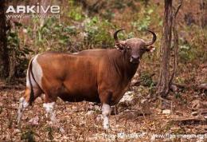
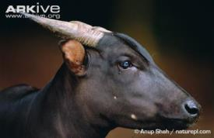
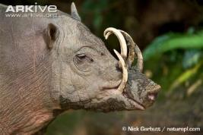
Global Species Management Plans (GSMPs) for Banteng, Anoa and Babirusa.
John Abernethy Programme Officer, IUCN SSC Asian Wild Cattle Specialist Group
Notes:
Mention the relevance to many Indonesian species, not just these 3 ungulates

Slide 2
The Asian Wild Cattle Specialist Group
One of over 120 Specialist Groups of the Species Survival Commission (SSC) developed by the International Union for the Conservation of Nature (IUCN).
One of the first Species Specialist Groups established in the early 1980s.
80 members, who are biologists, conservationists, and zoo professionals.
Currently the group is working on an Action Planning process – so prioritisation of activities is at species level.
Notes:
Many members are in-country experts
The action planning process will define and priorities the activities for each species.

Slide 3
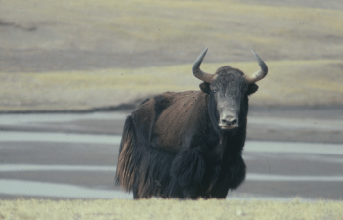
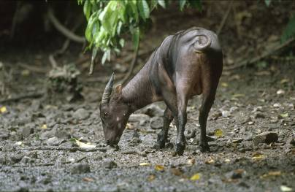
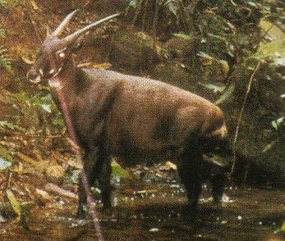
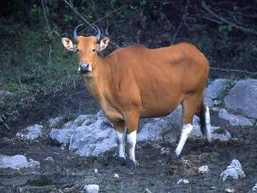
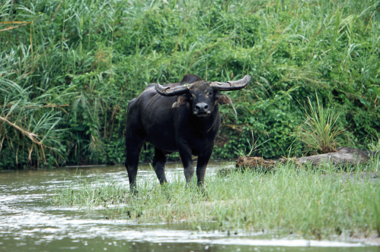
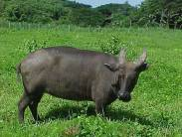
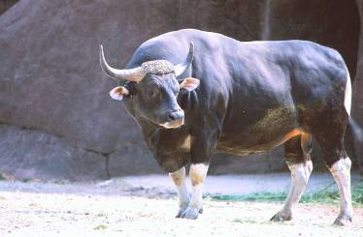
Yak
Anoa
Saola
Banteng
Tamaraw
Water Buffalo
Gaur

Slide 4
What is a Global Species Management plan?
A Global Species Management Plans (GSMP) is a strategic species management framework that aims to ensure the long term survival of species at risk from extinction.
The plan brings together international expertise from zoos, conservation organisations and governments through a combination of conservation action both in zoos (ex-situ ) and in the field (in-situ) in a one plan approach
The GSMPs are managed by the World Association for Zoos and Aquariums (WAZA) and representative committees

Slide 5
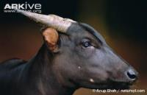
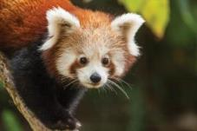
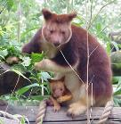
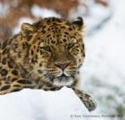
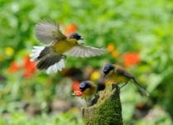
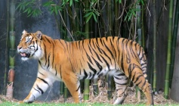
9 GSMPs to date:
Notes:
Manageemnt committee. 6 to date. 1st ungulates
5

Slide 6
Banteng, anoa and babirusa
All 3 are found in Indonesia and are threatened with extinction from human activities including hunting and habitat destruction.
In 2016 Global Species Management Plans (GSMPs) were created for anoa, banteng and babirusa with the aim to protect the species from extinction.
These are the first GSMP’s for any ungulates

Slide 7
What are the GSMPs Goals?
Reaching a demographically and genetically healthy global ex situ population
Population management & Capacity building
Awareness raising for zoo visitors
Zoo expertise to help in situ activities:
E.g. support management of rescued animals
Prioritize and support in situ projects

Slide 8
Goal 1: Reaching a demographically and genetically healthy global ex situ population
Genetic Target
Maintaining 90% of the gene diversity of the wild population for 100 years
Demographic Targets
 | Banteng |  | Anoa |  | Babirusa
 | 2015 | Target | 2015 | Target | 2015 | Target
Global | 203 | 300 | 182 | 300 | 190 | 355
Indonesia | 86 | 100 | 37 | 75 | 75 | 100
Europe | 89 | 100 | 53 | 75 | 23 | 100
Indonesian populations are very important because of number of animals and number of founders (high genetic diversity).
More breeding is needed to reach the target population
Notes:
1st step - Increase effectiveness of breeding of Indonesian zoo population, including breeding recommendations.
Inter-regional transfers could occur when Indonesian population is near target. No deadline for targets yet, as still working on the data. Then look at improving genetics of the other regional populations.
If you take on holding these species there are many opportunities for you to talk to your visitors about your involvement in the partnership and the activities in Indonesia.

Slide 9
Role 2: Awareness raising for zoo visitors
Support the needs of ex situ programmes (zoos & organisations): Including staff training and support of conservation education work and develop a “tool-kit” for education e.g. signage

Slide 10
Role 3: Zoo expertise helping in situ efforts
Encourage and enable interface between in situ and ex situ : expertise from both in situ and ex situ sources supporting each other and guiding best practice in husbandry and breeding.
This includes:
helping rescue centres to care for confiscated animals (vet training, technical assistance, restraining/handling/transfer)
Help with problem animals
Education for local communities: assistance for planning and design of a visitor centre in Alas Purwo National Park

Slide 11
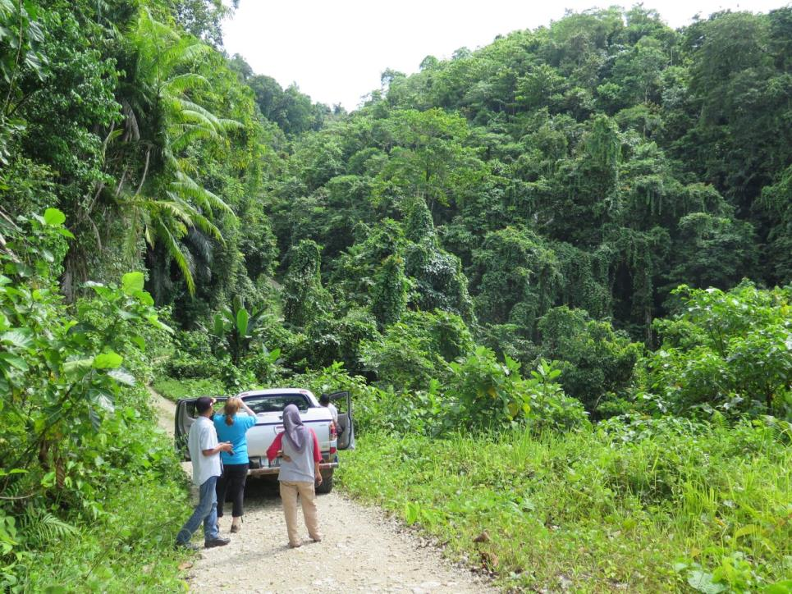
Role 4: Supporting in situ
In-situ (in the field) education & conservation initiatives: including research of wild populations, working with stakeholders within communities and developing educational outreach programmes.
Develop 1 long-term site-based project
Population monitoring system
Provide small grant to assist short term projects:
Survey on Sula and Buru for Hairy Babibura
Sulawesi multi-site outreach for babirusa and anoa
Training course for population monitoring at Ujong Kulon NP

Slide 12
One Plan Approach
Ex situ conservation breeding – global meta populations ex situ and in situ​
Capacity building and exchange of experience for ex situ conservation breeding​
Using ex situ expertise to help with in situ problems (rescue animals, conservation education, strategy planning, field work,…)​
Financial support for in situ​
All zoos can join in and help!!!

Slide 13
One Plan Approach
Notes:
Implementing partners: All contributing expertise, staff time or financial support

Slide 14
GSMP education focus
What can we do to be a part of it?
As zoo educators, conservationists and representatives for the GSMP we can spread the word about the global collaboration and conservation work being done to safeguard banteng, anoa and babirusa from extinction and inspire and enable people to get involved in protecting these enigmatic species.
Zoos can support each other to ensure staff are trained to the highest standard so that they can implement breeding recommendations
Zoos can also support others in developing signage and learning materials and education plans

Slide 15
Education focus
Raising community awareness
Zoos and their education teams can assist local NGO’s, National Park offices and local authorities by sharing their skills and experience such as:
Assisting them in improving education skills of staff
Increase the variety and quality of tools and strategies used to educate local communities
Assist with strategic planning for conservation education as few in situ activities have strategic educational plans
Help to design effective signage and visitor centres for National Park headquarters or visitor centres

Slide 16
We are all a part of this!!!

Slide 17
Acknowledgements

