Slide 1
Why is
conservation education important?
Mengapa pendidikan konservasi itu penting?
Notes:
Potential for discussion – to help us understand why it is important in their context. Discuss in pairs/threes and feedback to wider group.

Slide 2
Biodiversity decline Penurunan biodiversitas
“On average, monitored species population abundance declined by 58 per cent between 1970 and 2012”.
Living Planet Index 2016, World Wildlife Fund for Nature
“Rata-rata, kemelimpahan populasi suatu spesies menurun 58% antara 1970 dan 2012”
Notes:
We are entering a new age – the anthropocene. Humans are use 1.6 planets each year – we have just 1. Our activities are causing massive species decline. These declines are bad for people and wildlife.
https://www.zsl.org/science/indicators-and-assessments-unit/living-planet-index
Https://www.zsl.org/science/news/landmark-report-shows-global-wildlife-populations-on-course-to-decline-by-67-per-cent
https://www.wwf.org.uk/sites/default/files/2016-10/LPR_2016_full%20report_spread%20low%20res.pdf?_ga=2.163443573.891185679.1506894596-224945848.1413476543

Slide 3
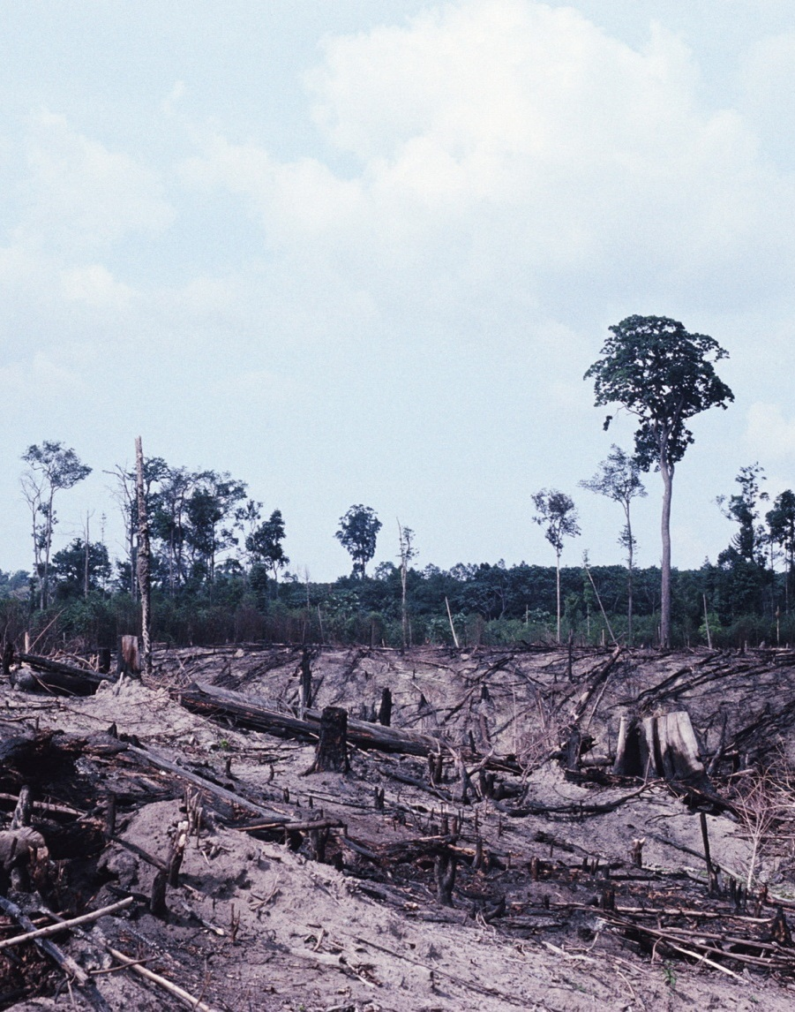
Threats to biodiversity Ancaman bagi biodiversitas
Hilangnya habitat dan
penurunan kualitas habitat
Eksploitasi jenis secara
berlebihan
Polusi
Jenis invasif dan penyakit
Perubahan iklim
Habitat loss and degradation
Species over exploitation
Pollution
Invasive species and disease
Climate change
Notes:
These five threats are all cited in Living Planet Index, amongst other publications.
They are complex problems – with many contributing factors (inequality, poverty, technology) but human created threats require human solutions – which means that motivating and education humans to take action to mitigate these threats is core to conservation.

Slide 4
The solution is people Masyarakat dapat menjadi solusinya
With the right skills, knowledge and motivation people can:
Protect and restore habitat and species
Consume less
Use resources more sustainably
Reduce pollution
Get involved in conservation efforts
Prevent extinctions
This is the overarching goal of conservation education.
Dengan keterampilan, pengetahuan, dan motivasi yang tepat, setiap orang dapat:
-Melindungi dan memperbaiki habitat dan jenis satwanya
-Mengurangi konsumsi satwa
-Menggunakan sumberdaya yang berkelanjutan
-Mengurangi polusi
-Terlibat dalam usaha konservasi
-Mencegah kepunahan
Ini adalah tujuan pendidikan konservasi
Notes:
In order to motivate people and create new social norms where communities take positive action, we use positive language and talk about what people can do to help (we don’t just focus on the declines and the threats). If participants feel that everyone is helping they will want to help too (conservation psychology).

Slide 5
Aichi Biodiversity Targets Target Biodiversitas Aichi
Target 1: Awareness increased
By 2020, at the latest, people are aware of the values of biodiversity and the steps they can take to conserve and use it sustainably.
Target 1: Kepedulian meningkat
Tahun 2020 akhir, masyarakat peduli akan nilai biodiversitas dan langkah yang mereka dapat lakukan untuk konservasi dan penggunaan secara berkelanjutan.
Notes:
From UN Convention on Biodiversity
Strategic Goal A: Address the underlying causes of biodiversity loss by mainstreaming biodiversity across government and society
Target 1 By 2020, at the latest, people are aware of the values of biodiversity and the steps they can take to conserve and use it sustainably.
Target 2 By 2020, at the latest, biodiversity values have been integrated into national and local development and poverty reduction strategies and planning processes and are being incorporated into national accounting, as appropriate, and reporting systems.
Target 3 By 2020, at the latest, incentives, including subsidies, harmful to biodiversity are eliminated, phased out or reformed in order to minimize or avoid negative impacts, and positive incentives for the conservation and sustainable use of biodiversity are developed and applied, consistent and in harmony with the Convention and other relevant international obligations, taking into account national socio economic conditions.
Target 4 By 2020, at the latest, Governments, business and stakeholders at all levels have taken steps to achieve or have implemented plans for sustainable production and consumption and have kept the impacts of use of natural resources well within safe ecological limits.
Strategic Goal B: Reduce the direct pressures on biodiversity and promote sustainable use
Target 5 By 2020, the rate of loss of all natural habitats, including forests, is at least halved and where feasible brought close to zero, and degradation and fragmentation is significantly reduced. Target 6 By 2020 all fish and invertebrate stocks and aquatic plants are managed and harvested sustainably, legally and applying ecosystem based approaches, so that overfishing is avoided, recovery plans and measures are in place for all depleted species, fisheries have no significant adverse impacts on threatened species and vulnerable ecosystems and the impacts of fisheries on stocks, species and ecosystems are within safe ecological limits.
Target 7 By 2020 areas under agriculture, aquaculture and forestry are managed sustainably, ensuring conservation of biodiversity.
Target 8 By 2020, pollution, including from excess nutrients, has been brought to levels that are not detrimental to ecosystem function and biodiversity.
Target 9 By 2020, invasive alien species and pathways are identified and prioritized, priority species are controlled or eradicated, and measures are in place to manage pathways to prevent their introduction and establishment.
Target 10 By 2015, the multiple anthropogenic pressures on coral reefs, and other vulnerable ecosystems impacted by climate change or ocean acidification are minimized, so as to maintain their integrity and functioning.
Strategic Goal C: To improve the status of biodiversity by safeguarding ecosystems, species and genetic diversity
Target 11 By 2020, at least 17 per cent of terrestrial and inland water, and 10 per cent of coastal and marine areas, especially areas of particular importance for biodiversity and ecosystem services, are conserved through effectively and equitably managed, ecologically representative and well connected systems of protected areas and other effective area-based conservation measures, and integrated into the wider landscapes and seascapes.
Target 12 By 2020 the extinction of known threatened species has been prevented and their conservation status, particularly of those most in decline, has been improved and sustained.
Target 13 By 2020, the genetic diversity of cultivated plants and farmed and domesticated animals and of wild relatives, including other socio-economically as well as culturally valuable species, is maintained, and strategies have been developed and implemented for minimizing genetic erosion and safeguarding their genetic diversity.
Strategic Goal D: Enhance the benefits to all from biodiversity and ecosystem services
Target 14 By 2020, ecosystems that provide essential services, including services related to water, and contribute to health, livelihoods and well-being, are restored and safeguarded, taking into account the needs of women, indigenous and local communities, and the poor and vulnerable. Target 15 By 2020, ecosystem resilience and the contribution of biodiversity to carbon stocks has been enhanced, through conservation and restoration, including restoration of at least 15 per cent of degraded ecosystems, thereby contributing to climate change mitigation and adaptation and to combating desertification.
Target 16 By 2015, the Nagoya Protocol on Access to Genetic Resources and the Fair and Equitable Sharing of Benefits Arising from their Utilization is in force and operational, consistent with national legislation.
Strategic Goal E: Enhance implementation through participatory planning, knowledge management and capacity building
Target 17 By 2015 each Party has developed, adopted as a policy instrument, and has commenced implementing an effective, participatory and updated national biodiversity strategy and action plan.
Target 18 By 2020, the traditional knowledge, innovations and practices of indigenous and local communities relevant for the conservation and sustainable use of biodiversity, and their customary use of biological resources, are respected, subject to national legislation and relevant international obligations, and fully integrated and reflected in the implementation of the Convention with the full and effective participation of indigenous and local communities, at all relevant levels.
Target 19 By 2020, knowledge, the science base and technologies relating to biodiversity, its values, functioning, status and trends, and the consequences of its loss, are improved, widely shared and transferred, and applied.
Target 20 By 2020, at the latest, the mobilization of financial resources for effectively implementing the Strategic Plan for Biodiversity 2011-2020 from all sources, and in accordance with the consolidated and agreed process in the Strategy for Resource Mobilization, should increase substantially from the current levels. This target will be subject to changes contingent to resource needs assessments to be developed and reported by Parties.

Slide 6
Meeting the target Mencapai target
People are aware of the values of biodiversity –
Biodiversity is not widely understood and as a result its economic, social and environmental importance is often poorly recognised.
Masyarakat peduli nilai keaneka ragaman –
Biodiversitas tidak secara luas dipahami dan hasilnya kepentingan ekonomi, sosial, dan lingkungan sering kurang diketahui.

Slide 7
Meeting the target Mencapai target
Masyarakat peduli aksi, mereka dapat melakukan konservasi dan penggunaan biodiversitas secara berkelanjutan -
Jika dapat lebih dipahami dengan baik, nilai biodiversitas penting dalam membangun motivasi untuk bertindak, meskipun itu saja tidak cukup. Individu juga perlu menyadari jenis tindakan yang dapat mereka lakukan untuk melestarikan dan memanfaatkan keanekaragaman hayati secara lestari. Segmen masyarakat yang berbeda dapat mengambil tindakan yang berbeda tergantung pada jenis aktivitas yang mereka kendalikan atau mereka pengaruhi. Informasi semacam itu dapat membantu memberdayakan individu untuk mengambil tindakan.
People are aware of the actions they can take to conserve and sustainably use biodiversity – While a better understanding of the values of biodiversity is important in building the motivation for action, its is not enough. Individuals also need to be aware of the types of actions they themselves can take in order to conserve and sustainably use biodiversity. Different segments of society can take different actions depending on the types of activities they have control or influence over. Such information can help to empower individuals to take action.

Slide 8
WAZA conservation strategy
Strategi konservasi WAZA
“With more than 700 million visitors annually passing through the gates of zoos and aquariums of the world, affiliated through regional associations of the World Association of Zoos and Aquariums (WAZA), zoological facilities have an unrivalled platform to engage the general public in conservation.”
“Lebih dari 700 juta pengunjung setiap tahun memasuki kebun binatang di seluruh dunia, yang terafiliasi dalam Asosiasi Kebun binatang dan Akuaria se dunia (WAZA), fasilitas satwa memiliki bagian penting untuk adanya interaksi publik secara umum dalam konservasi.”

Slide 9
WAZA list of responsibilities Daftar tanggung jawab WAZA
Zoos and aquariums readily accept the responsibility that comes with maintaining and caring for animals.
Lead, support and collaborate with education programmes that target changes in community behaviour towards better outcomes for conservation
Provide a public arena to discuss and debate the challenges facing society as extinction accelerates and ecosystem services are degraded
Provide ethical and moral leadership
Lembaga konservasi siap bertanggung jawab dalam pemeliharaan dan perawatan satwa.
-Mendukung dan bekerjasama dengan program edukasi untuk merubah perilaku masyarakat ke arah yang lebih baik untuk konservasi.
-Menyediakan ruang publik untuk berdiskusi dan tukar pendapat mengenai tantangan yang dihadapi masyarakat seiring meningkatnya kepunahan dan ekosistem yang semakin rusak.
-Melatih program kepemimpinan etika dan moral

Slide 10
Vision - Visi
Creating a culture of education
“By helping to create a culture of conservation in our communities, zoos and aquariums are a vital part of the process of generating the attitude and will needed to save species and maintain healthy ecosystems.”
Membuat budaya pendidikan
“Dengan membantu membuat konservasi sebagai budaya di komunitas kita, lembaga konservasi merupakan bagian vital dari proses pembentukan perilaku dan diperlukan untuk menyelamatkan suatu jenis satwa dan menjaga ekosistem yang sehat.”

Slide 11
Recommendations Rekomendasi
Talk about conservation throughout the institution and facilitate the uptake of pro-environmental behaviours that reduce human impacts on wild populations.
Membahas konservasi secara menyeluruh melalui institusi dan memfasilitasi adanya perilaku yang peduli lingkungan yang mengurangi pengaruh manusia terhadap populasi satwa liar.
Use media contacts to disseminate the conservation message.
Menggunakan media untuk menyebarkan pesan konservasi

Slide 12
Recommendations Rekomendasi
Establish relationships with local members of government by inviting them into the institution and advocate for conservation.
Membangun hubungan dengan pemerintah daerah dengan mengundang mereka ke institusi dan mendukung konservasi
Publicise every success, however small, to endorse the mission and status of the zoo or aquarium in the community.
Mempublikasikan setiap keberhasilan, sekecil apapun, untuk mendukung misi dan status lembaga konservasi di tengah masyarakat

Slide 13
Vision - Visi
Engagement – Influencing behaviour change for conservation
“Zoos and aquariums are trusted voices for conservation, and are able to engage and empower visitors, communities and staff measurably to save wildlife.”
Keterlibatan masyarakat – Mempengaruhi perubahan perilaku konservasi
“Lembaga konservasi dipercaya mampu menyuarakan konservasi dan mampu melibatkan pengunjung, penduduk sekitar dan staff secara terukur untuk menyelamatkan satwa.”

Slide 14
Recommendations Rekomendasi
Create a measurable engagement framework.
Membuat kerangka kerja untuk pelibatan masyarakat secara terukur
Design programmes that engage visitors in pro-conservation behaviours, especially local issues that may affect or impact visitors.
Mendesain program yang melibatkan pengunjung agar berperilaku mendukung konservasi, terutama isu lokal yang mungkin mempengaruhi pengunjung.
Invest in the education strategy and evaluation skills of staff.
Investasi dalam strategi pendidikan dan evaluasi keterampilan staff

Slide 15
Recommendations Rekomendasi
Define the targeted behaviours and how they will be communicated to the visiting public (e.g. young children, school groups, adults), and specify how impact will be evaluated.
Menentukan perilaku yang menjadi target dan bagaimana komunikasinya ke pengunjung umum (misalnya anak kecil, kelompok sekolah, orang dewasa), dan khususnya bagaimana pengaruhnya akan dievaluasi.
Seek collaborations with universities, museums, other zoos and aquariums, and conservation organisations.
Berkolaborasi dengan perguruan tinggi, museum, lembaga konservasi dan LSM konservasi yang lain.

Slide 16
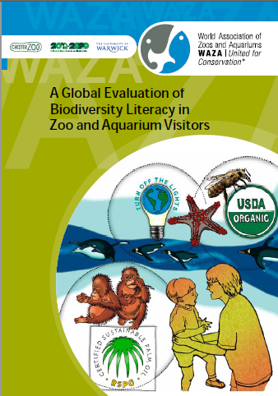
Evidence for zoos Fakta bagi lembaga konservasi
In a study of 6,000 visitors to 30 zoos researchers found that after a zoo visit visitors showed:
increased understanding of biodiversity
increased knowledge of pro-biodiversity action
Sebuah studi dari 6.000 pengunjung pada 30 lembaga konservasi, menunjukkan bahwa setelah mengunjungi lembaga konservasi, para pengunjung menunjukkan:
-Pemahaman biodiversitas meningkat
-Pengetahuan yang mendukung aksi bagi biodiversitas meningkat pula
Notes:
There is evidence that a zoo visit can contribute to biodiversity literacy.
Zoos and aquariums worldwide (within WAZA and regional zoo associations, attract more than 700 million visits every year and therefore have massive potential to make a positive contribution to Aichi target 1 and to helping to mitigate the threats that biodiversity faces. Social scientists from Chester Zoo, WAZA and Warwick University conducted a large-scale impact evaluation study, using a pre- and post-visit repeated-measures survey design, to evaluate biodiversity literacy – biodiversity understanding and knowledge of actions to help protect biodiversity – in zoo and aquarium visitors.
This was the largest and most international study of zoo and aquarium visitors ever conducted worldwide; in total, more than 6,000 visitors to 30 zoos and aquariums around the globe participated in the study. The study's main finding is that aggregate biodiversity understanding and knowledge of actions to help protect biodiversity both significantly increased over the course of zoo and aquarium visits. There was an increase from pre-visit (69.8%) to post-visit (75.1%) in respondents demonstrating at least some positive evidence of biodiversity understanding. Similarly, there was an increase from pre-visit (50.5%) to post-visit (58.8%) in respondents that could identify a pro-biodiversity action that could be achieved at an individual level. This study provides the most compelling evidence to date that zoo and aquarium visits can contribute to increasing the number of people who understand biodiversity and know actions they can take to help protect biodiversity.

Slide 17
Why zoo education is important
Mengapa pendidikan di lembaga konservasi itu penting
“Long-term conservation success will be linked to how zoos and aquariums engage with their visitors and change behaviour.”
“Kesuksesan konservasi jangka panjang akan terkait dengan bagaimana lembaga konservasi melibatkan pengunjungnya dalam perubahan perilaku konservasi.”
http://www.waza.org/en/site/conservation/conservation-strategies
Notes:
WAZA 2015 Strategy – Committing to Conservation makes the case for zoos to engage visitors, and particularly to focus on behaviour change.

Slide 18
Thank you
Terima kasih

